Slide 1
Ride, SALI, Ride!
A Dashboard Approach to Instruction Program Management
Doreen Bradley, Laurie Sutch
University of Michigan Library

Slide 2
Why do it?
Too many individual systems + class volume
Confusing for schedulers & instructors
Double and triple data entry
2011-2013 Statistics
1,346 sessions
26,994 attendees
~ 90 library instructors

Slide 3
Previous systems
Instruction requests come through multiple avenues
Calendars for each teaching lab plus an Instruction Calendar
Registration system for “open workshops”
Evaluation system
Email messages to assign library instructors to classes

Slide 4
Demo of SALI
Request form
Instructor dashboard
Scheduler’s view
Notes:
Request form
- contact info automatically set by user login; if making the session for someone else, can change name
- course specific vs. open
- topics
- request dates: alternate dates vs. duplicate requests
- attachments
- instructor options: type of session, need room, claim session, requested time is scheduled time, evals
- open ended comment box
Instructor Dashboard
- review various tabs
- can sort, search, change default number per page
- click on title to see full info about session, see attachment, and claim session
- can use green claim button from main dashboard if no one has claimed it yet
- when you claim a session, when it is scheduled (and if that changes), it goes on your personal calendar
FLIP BACK TO PRESENTATION AND SHOW NEXT SLIDE (screenshot of calendar)
- record statistics
- view evaluations, see list of recent sessions in Eval list (at top) - give this link to students
- can then see summary of evaluations
- using Qualtrics, manual process, perhaps in future different integration
Schedulers
- can choose to receive notification of new sessions, then make sure that
- it’s a reasonable length of time
- a room is available that can accommodate the size of the group as well as the software then they set the time
- depending, may assign an instructor or leave it up for people to claim
- if an evaluation is requested, create the report in Qualtrics, then copy/paste into SALI
- put into registration system

Slide 5
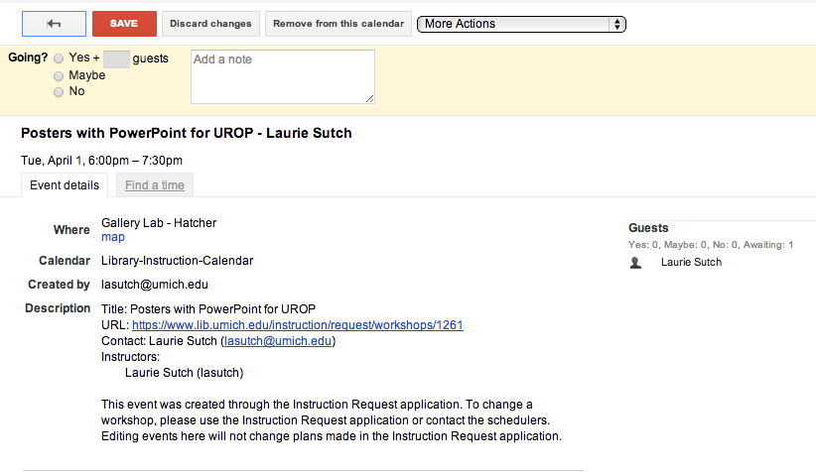

Slide 6
Challenges
Time & flexibility from programmers and librarians
Buy-in from library instructors in a very decentralized institution
Evaluations in Qualtrics

Slide 7
Conclusions
SALI vastly decreases scheduling time
Provides easy access to data
Single point of information for instructors & schedulers
Time and commitment from stakeholders are essential

Slide 8
Questions?
Doreen Bradley (dbradley@umich.edu)

Slide 9
Screenshots just in case

Slide 10
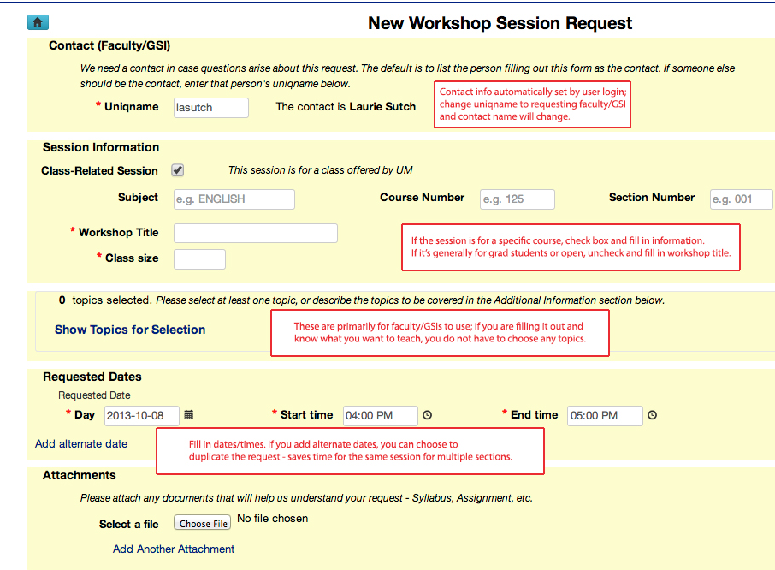

Slide 11
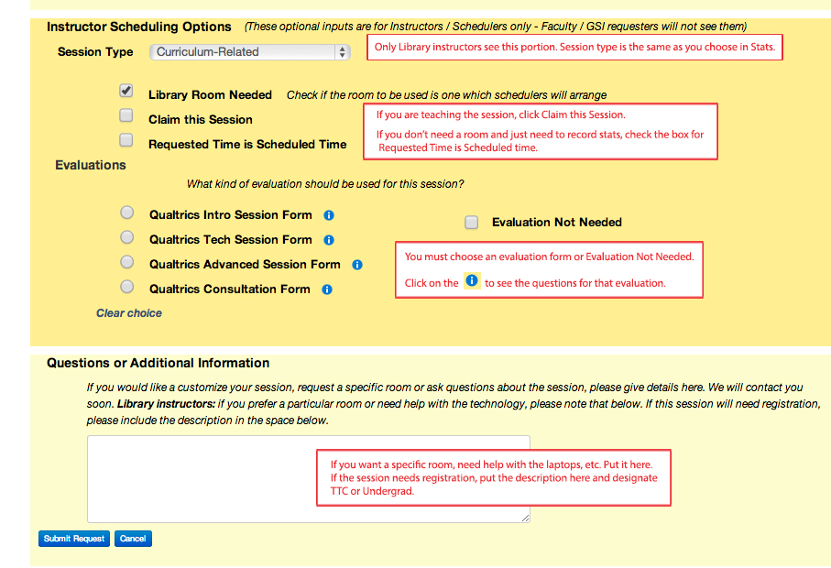

Slide 14
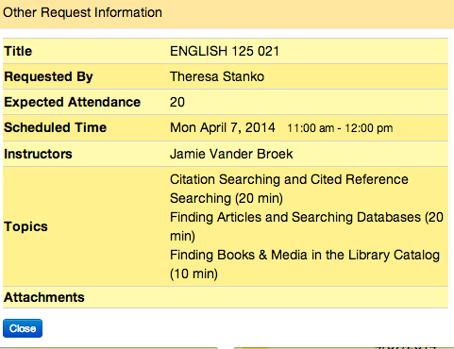
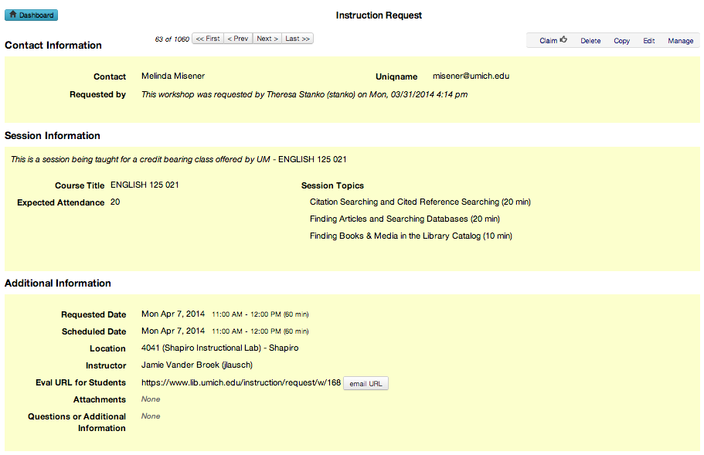

Slide 15
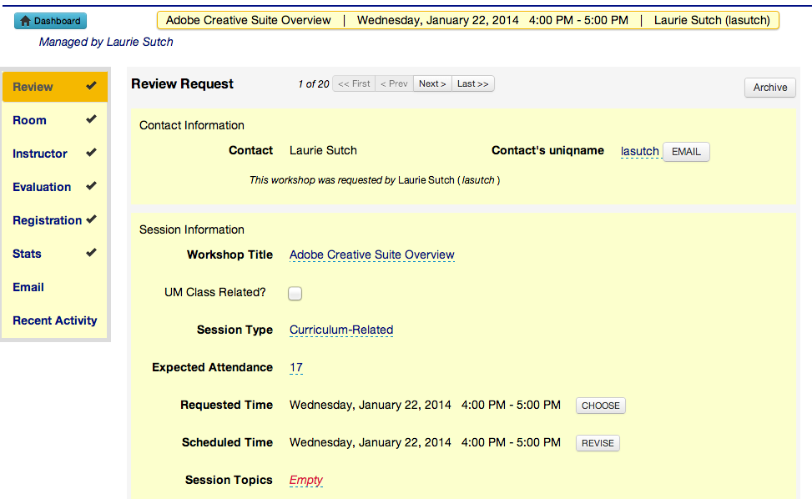

Slide 16
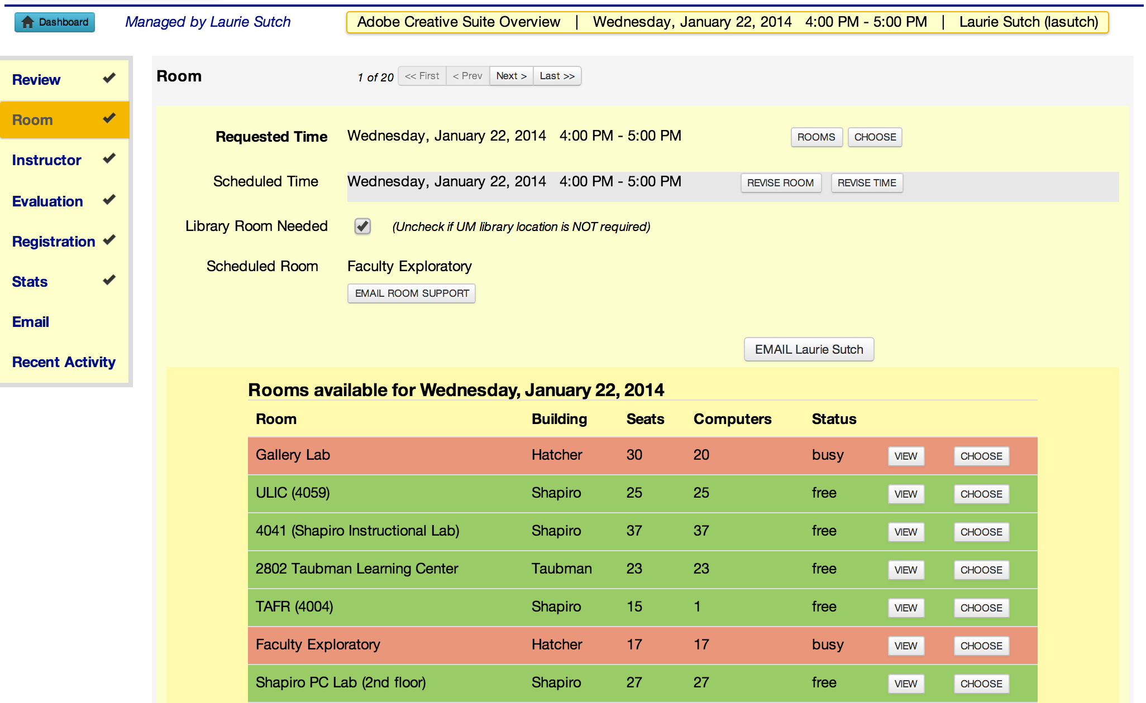

Slide 17
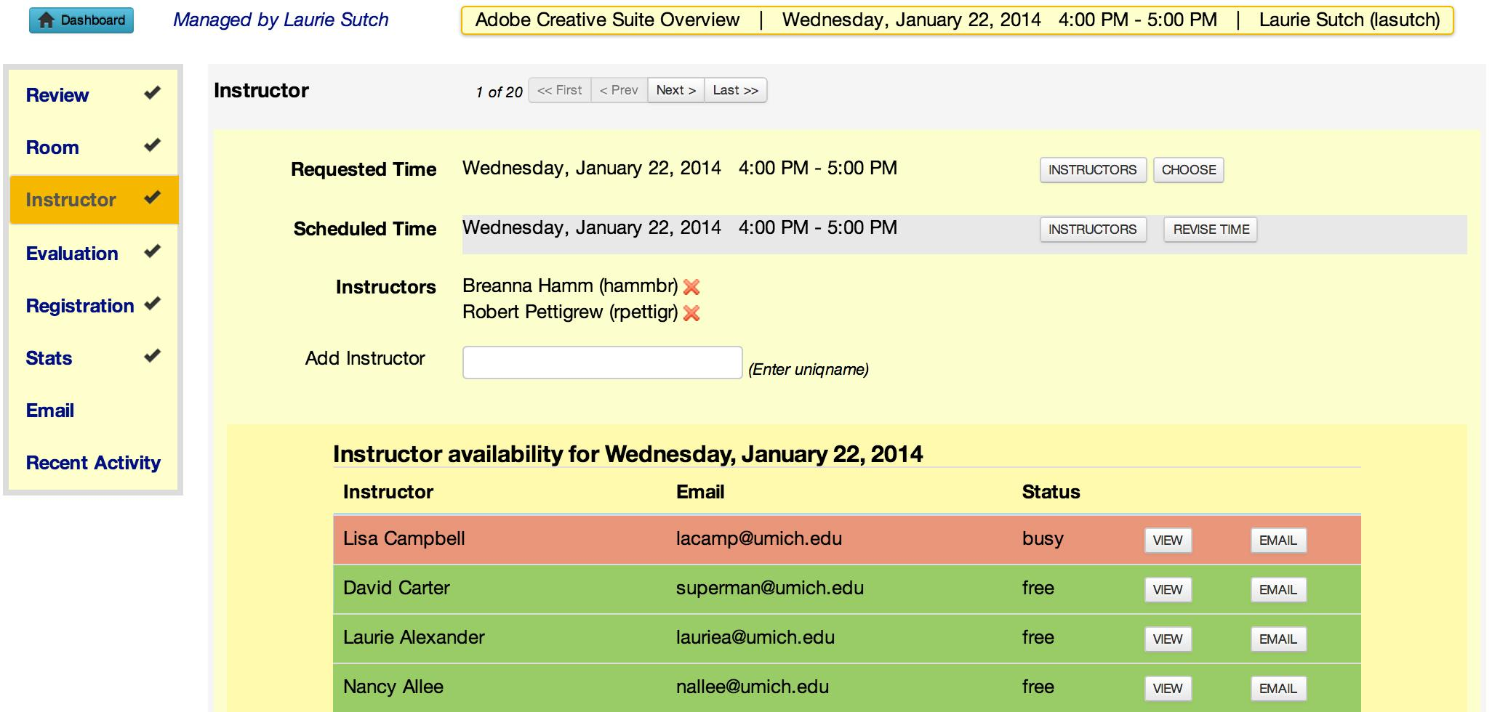

Slide 18
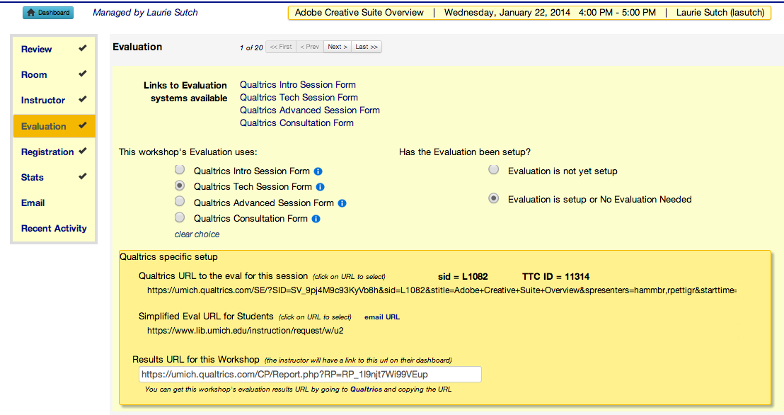

Slide 19
